Slide 1
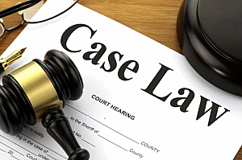
THE ENGLISH LEGAL SYSTEM CASE LAW AND PRECEDENT
This Photo by Unknown Author is licensed under CC BY-SA

Slide 2
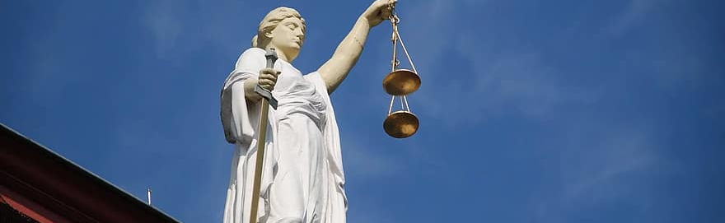
LL1005 English Legal System (ELS)
DR.SAHAR MARANLOU
SAHAR.MARANLOU@RHUL.AC.UK

Slide 3

LECTURE OVERVIEW
How law is developed through case law – the rules of precedent
How judges use cases to follow rules and to depart from them
How to use cases in your studies

Slide 4

Objectives
Explain the elements and types of precedent.
Understand the court hierarchy (another lecture- next lecture ).
Discuss how a precedent can be altered or avoided, including the roles of the Supreme Court and Court of Appeal about precedent.
Discuss the advantages and disadvantages of precedent and the limitations on judicial law-making.

Slide 5
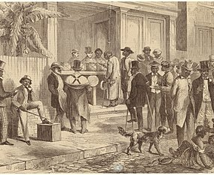
Introduction
LEGAL TRADITIONS
Common Law
The English and Welsh legal systems are common law systems, which means that courts have developed much of our law over time.
law is developed by judges using a system of judicial precedent.
Judicial Precedent refers to the source of law where past decisions of the judges create law for future judges to follow. It is also known as case law.
This Photo by Unknown Author is licensed under CC BY-SA

Slide 6

Topic one
How is law developed through case law?

Slide 7
WHAT IS CASE LAW?
Case law is a set of judge-made rules or decisions of the higher courts
Case law is a major source of law providing for the interpretation of statutes and the development of common law rules
Case law is also referred to as common law
The system of precedent is dependent on us being able to find out what the courts have ruled
Decisions of judges are known as judgments and recorded in law reports
This Photo by Unknown Author is licensed under CC BY-SA

Slide 8
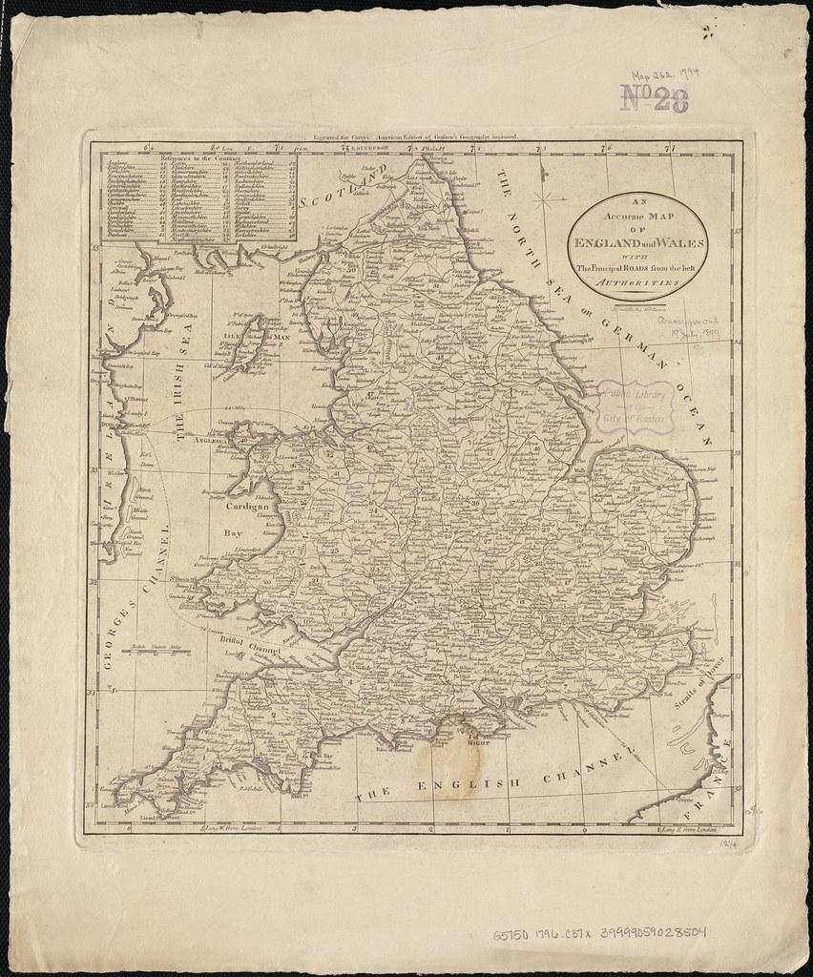
England and Wales
The English and Welsh legal systems are common law systems, which means that courts have developed much of our law over time.
law is developed by judges using a system of judicial precedent.
Judicial Precedent refers to the source of law where past decisions of the judges create law for future judges to follow. It is also known as case law.

Slide 9
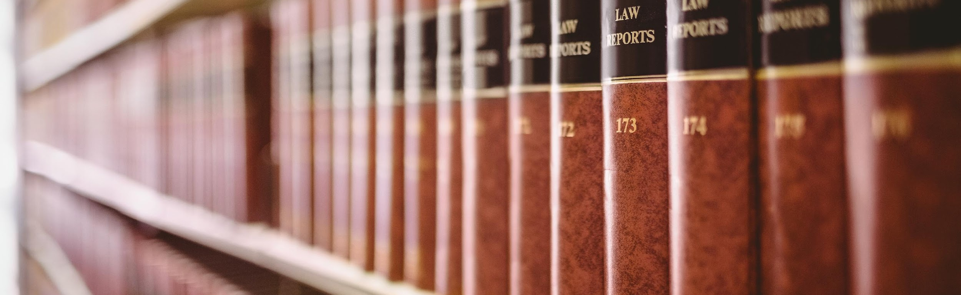
LAW REPORTS
Records of court decisions are known as ‘law reports’
Law reports can be divided into two historical phases – pre- and post- 1865
Cases in the inferior courts are not routinely reported
Not all cases in the superior courts are reported

Slide 10

Precedent
STARE DECISIS
Stand by what has been decided
This Photo by Unknown Author is licensed under CC BY-NC-ND

Slide 11

Topic Two
Precedent

Slide 12
STARE DECISIS
like cases are decided alike
higher courts bind lower courts
A later court must use the same reasoning as a previous case where the two cases raise the same legal issues
Decisions of higher courts are binding on lower courts

Slide 13
Like cases are decided alike
The Judgment
JUDGMENT
BINDING
PRECEDENT
PERSUASIVE
PRECEDENT
RATIO DECIDENDI
OBITER
DICTA
“reasons for deciding”
“other things said”

Slide 14
THE COURT HIERARCHY
The Privy Council
Supreme Court
European Court of Human Rights
Court of Appeal
Civil Division
Court of Appeal
Criminal Division
High Court
Family
High Court
Chancery
High Court
King’s Bench
Family Court
County Court
Crown Court
Magistrates Court

Slide 15
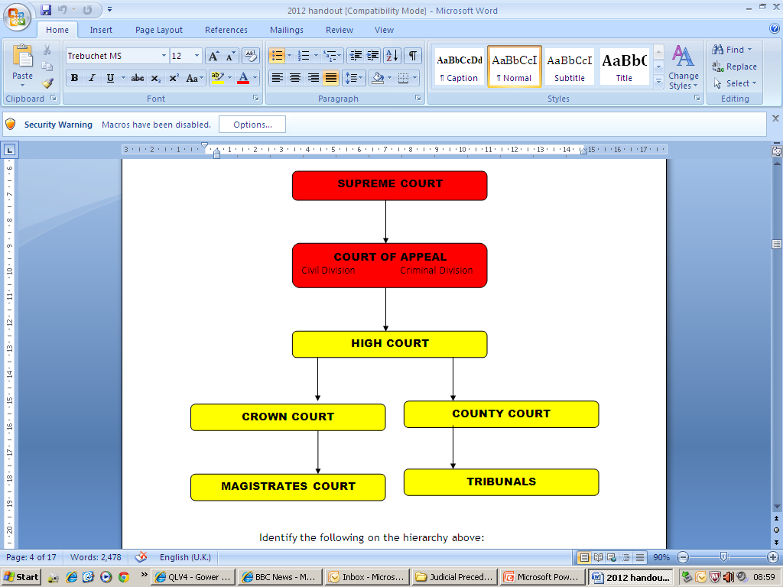
Higher courts bind lower courts
The Court Hierarchy
Can create ORIGINAL precedent

Slide 16
PRECEDENT AND THE COURTS
Court | Status
Court of Justice of the European Union | Pre-Brexit - bound the UK ONLY on matters of EU law
Privy Council | Persuasive authority only
European Court of Human Rights | Persuasive authority only

Slide 17
PRECEDENT AND THE COURTS
Court | Status
Supreme Court | Binds all lowers courts and is generally bound by itself (see exceptions)
Court of Appeal | Bound by Supreme Court, binds all lower courts and is generally bound by itself (see exceptions)
Divisional Court | Bound by the Supreme Court and Court of Appeal, binds all lower courts and is generally bound by itself
County Court | Bound by all higher courts, binds no court
Crown Court | Bound by all higher courts, binds no court
Family Court | Bound by all higher courts, binds no court
Magistrates’ Court | Bound by all higher courts, binds no court

Slide 18
THE SUPREME COURT
After creation of the Supreme Court in October 2009 - it has been confirmed that the same approach applies (Austin v Mayor and Burgesses of the LBC (2010)).
Pre-1966 the House of Lords were bound by their own previous decisions
1966
Oct. 2009
Practice Statement (Judicial Precedent)(1966) - The House of Lords could depart from a previous decision where it appeared ‘right to do so’. E.g. R v Shivpuri [1987]

Slide 19
Supreme Court and Precedent
It was issued because it was recognised by the Law Lords that “too rigid adherence to precedent may lead to injustice in a particular case and also unduly restrict the proper development of the law”.
The power only applies to the Supreme Court and no other court within the hierarchy.
In 1966, the Lord Chancellor issued the Practice Statement allowing the House of Lords to depart from their previous decision “where it appears right to do so”.

Slide 20
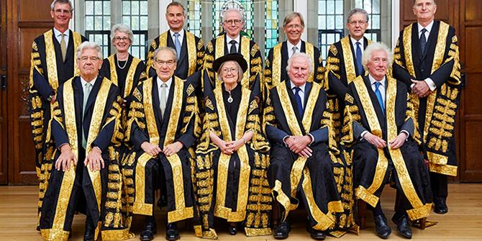
THE SUPREME COURT/HOUSE OF LORDS
Judges are very reluctant to depart from their previous decisions:
‘If the House in its judicial capacity has erred, it is usually better to leave it to Parliament to change the law prospectively than for the House to undo its mistake with retrospective effect’ (Lord Hoffmann in Horton v Sadler [2006]
But will do so in rare cases where they think the decision is wrong:
‘My Lords, I think that judges and academic writers have picked over the carcass of this unfortunate case so many times in attempts to find intelligible meat on its bones that the time has come to call a halt’ (Lord Hoffmann in R v G [2008]

Slide 21
TOPIC THREE
How do judges use cases to follow rules and to depart from them?

Slide 22

Persuasive Precedent
Persuasive Precedent is judgments which do not HAVE to be followed, but could provide good law for judges to follow:
Courts lower in the hierarchy
Decisions of the Privy Council
Statements made obiter dicta
A dissenting judgment
Decisions of other common law jurisdictions.

Slide 23
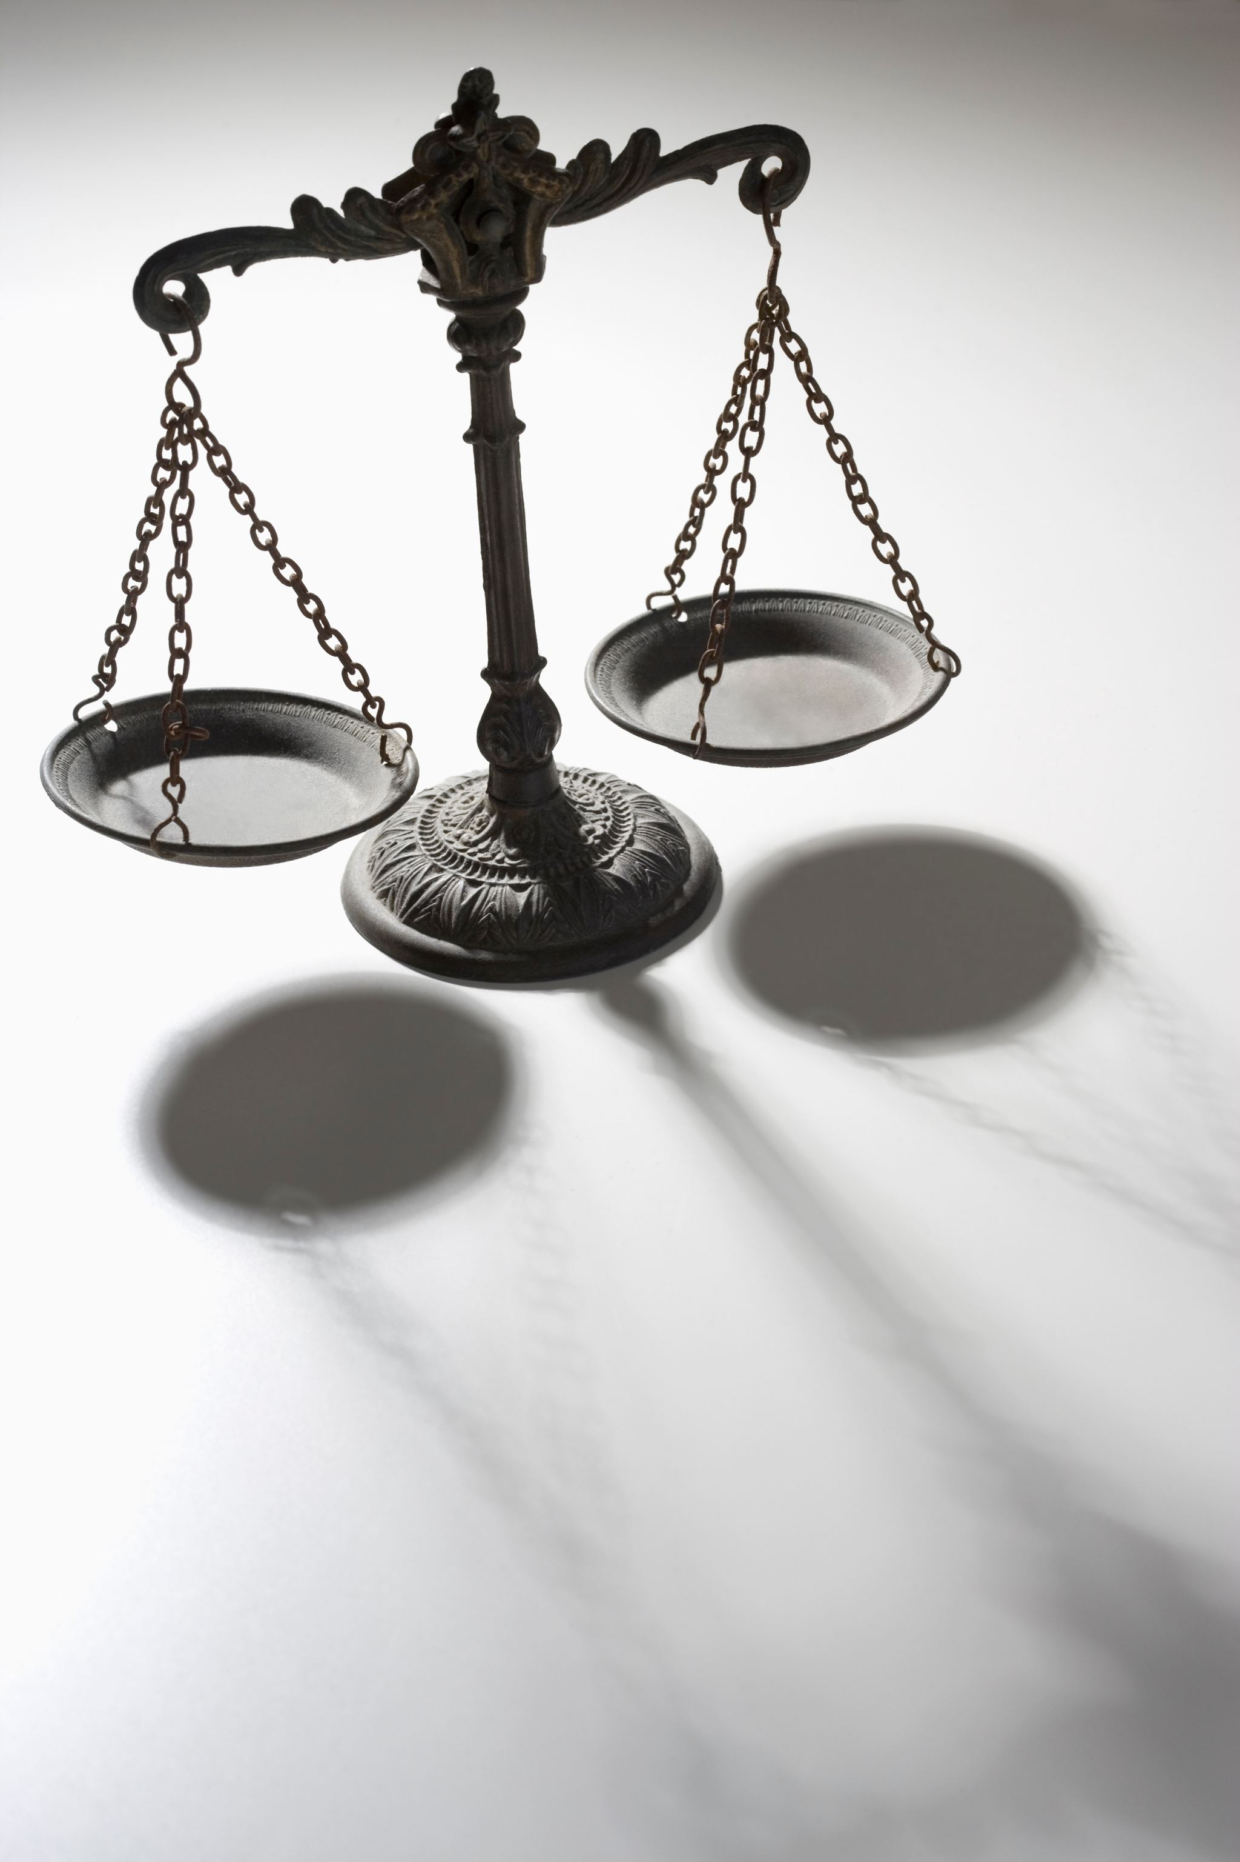
Original Precedent
Some areas of our law originate entirely from judicial precedent, in other words, law made by judges. This is called original precedent.
What are the immediate problems with “judge made law”?
R v R (1991)
Donoghue v Stevenson (1932)
Gillick v West Norfolk and Wisbech Area Health Authority (1985)

Slide 24
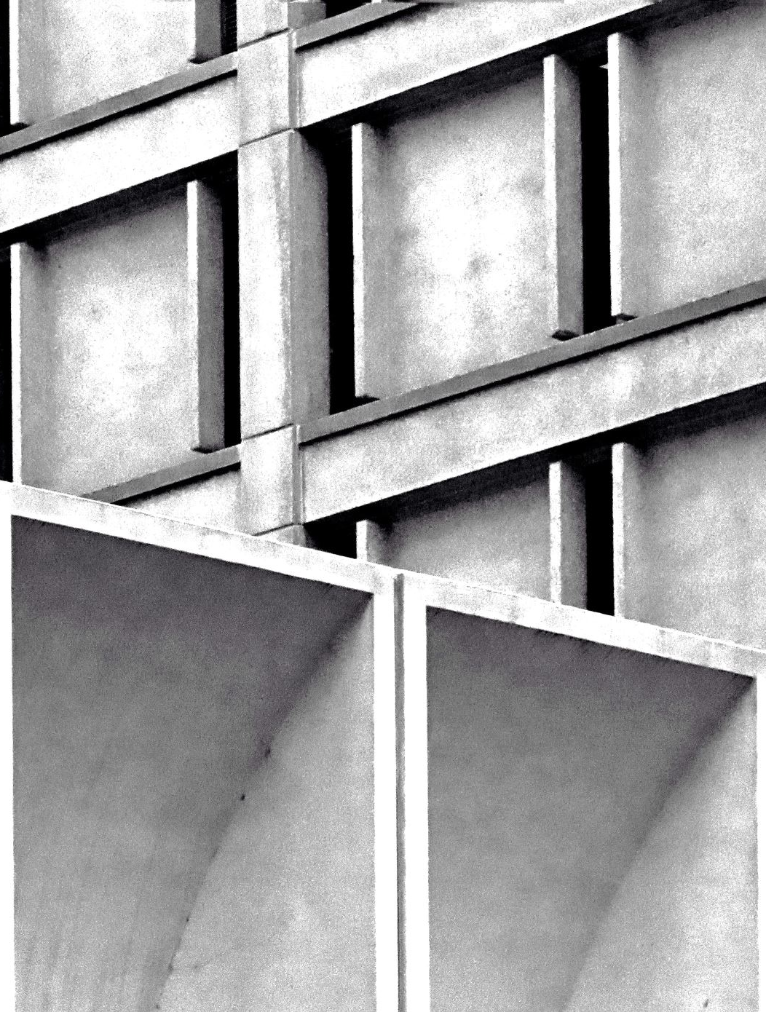
Avoidance Techniques
Overrule
Higher courts can overrule lower courts.
Example: Candler v Crane Christmas & Co (1951) was overruled in Hedley Byrne v Heller & Partners Ltd (1964)
Reverse
on appeal, a higher court may change the decision of a lower court.
Example: Re Pinochet (1999)
Distinguish
where a lower court is able to point to material differences that justify the application of different principles.
Example: Balfour v Balfour was distinguished in Merritt v Merritt

Slide 25
HOW TO AVOID FOLLOWING A DECISION
Overruling – where a court higher up in the hierarchy overturns the decision of a lower court in a different case. The lower court decision is then negated of any legal force.
Reversing – Here the higher court overturns the decision of a lower court in the same case eg SC fails to uphold the outcome in the CA in the same case.
Distinguishing – Court decides the facts are materially different so they do not have to follow the precedent (but the precedent remains good law – if limited). They can also interpret the ratio more widely or narrowly’
Changing the law – where the SC decides that the law was erroneously applied or should be applied differently etc.

Slide 26
Court of Appeal and Precedent Young v Bristol Aeroplane Co (1944)
Civil Division:
The Court of Appeal is bound by the decisions of the Supreme Court or House of Lords as it was, but it is also bound by its own previous decisions EXCEPT in the limited circumstances laid down in Young:
Where there are two conflicting previous decisions;
Where a previous decision has been overturned by a later House of Lords/Supreme Court decision;
Where the previous decision was ‘per incuriam’ (wrongly decided)

Slide 27
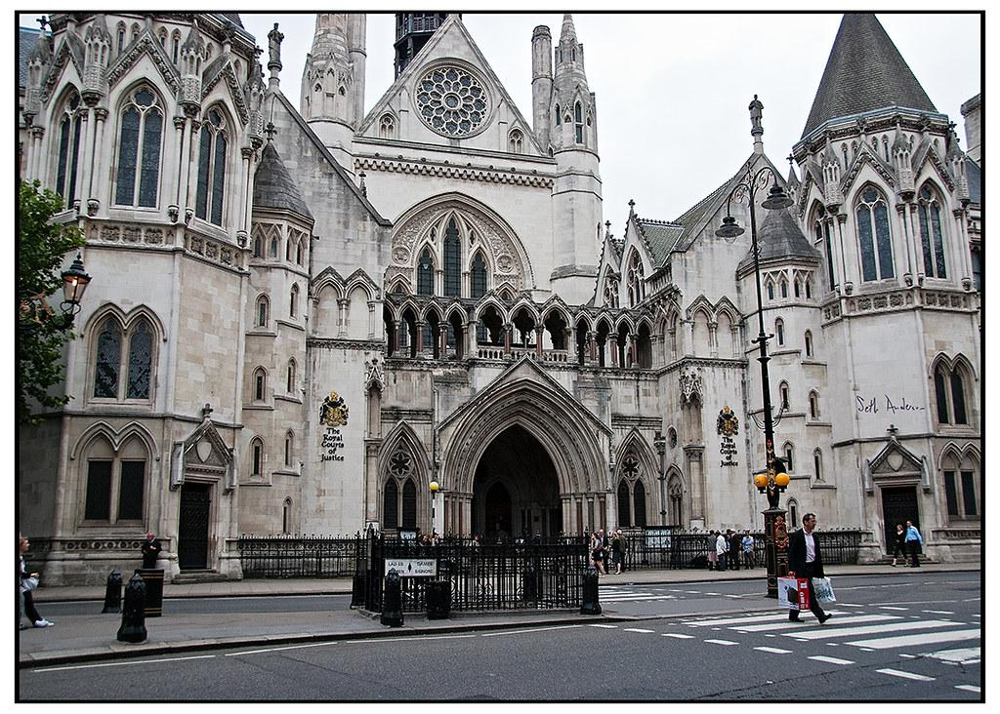
PRECEDENT AND THE COURTS – COURT OF APPEAL (CRIMINAL DIVISION)
R v Spencer [1985] QB 771
The exceptions from Young v Bristol Aeroplane apply to the Criminal Division too.
The Criminal Division has a wider discretion than the Civil Division where the liberty of the individual is at stake.

Slide 28
Criminal Division
The Court of Appeal is bound by the decisions of the Supreme Court or House of Lords as it was, but it is also bound by its own previous decisions EXCEPT in the limited circumstances laid down in Young:
Where there are two conflicting previous decisions;
Where a previous decision has been overturned by a later House of Lords/Supreme Court decision;
Where the previous decision was ‘per incuriam’ (wrongly decided)=
AND: Where, in the previous case, the law was misapplied/misunderstood resulting in a conviction – R v Taylor (1950). This extra flexibility is due to the fact that we are dealing with the liberty of the citizen.

Slide 29
Impact of the Human Rights Act 1998
Vinter v UK (2013)
This was a group of cases concerning some of the UK’s most dangerous criminals, who appealed to the Court of Appeal because their sentence of a “whole life order” was a breach of Article 3 ECHR – right to be free from inhuman and degrading treatment.
The ECHR ruled that whole life orders were in breach of Article 3 and that a review mechanism should be in place to assess whether a whole life term was still necessary. It recommended this review should be left no later than 25 years into the sentence.

Slide 30

s2 Human Rights Act 1998
Requires all judges, when deciding on Convention points, to ‘take account’ of the case law of the European Court of Human Rights.
This effectively creates a new source of case law.
This Photo by Unknown Author is licensed under CC BY-SA

Slide 31
Advantages of Precedent
Certainty :
The precedent system encourages consistency as cases are decided alike.
Flexibility:
Judges can distinguish cases on their facts.
The Practice Statement allows the law to develop and adapt, thus keeping up with modern times.
The precedent system has enabled whole areas of law to grow.
Notes:
This means that the system is predictable, and therefore people can plan ahead with reasonable confidence that they are acting within the law.

Slide 32
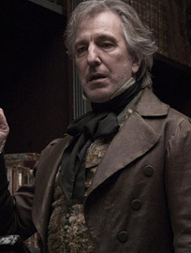
Objectivity
It prevents judges from exercising personal prejudices, makes the courts’ decisions more transparent, and creates legal rules that are objectively acceptable.
This Photo by Unknown Author is licensed under CC BY-SA

Slide 33

Legal Growth
This means that new laws can be created to deal with difficult and new legal dilemmas.
Airedale NHS Trust v Bland (1993) on the question of whether a life support machine should be switched off when a person was in a persistent vegetative state; and the case Re A (2000) on the question whether Siamese twins should be separated by an operation when the hospital recommended this, but where the patient had clearly expressed their opposition.
Legal growth also comes in the light of practical experience.
This Photo by Unknown Author is licensed under CC BY-SA

Slide 34

Disadvantages of Precedent
Judges’ views are NOT OFTEN to represent those of the general public.
This system is rigid as the lower courts have to follow the decisions of higher courts.
It can be argued that the Court of Appeal should be allowed to overrule decisions of the House of Lords in certain defined circumstances, as it is often the ultimate court for most litigants.

Slide 35

coherent legal development
Only the House of Lords is in a position to give an ultimate ruling on an issue before the courts, and it is extremely expensive and time-consuming to get a case this far.
Even then, the Practice Statement means that the law might still need to be settled.
The system of precedent cannot initiate legal change since it has to wait for an appropriate case to come before the courts.
Judicial precedent leads to complex and imprecise bodies of law, thus encouraging speculative litigation.

Slide 36




PRECEDENT AND STARE DECISIS
Courts are normally bound by decisions of courts that are higher or equal to them (with some exceptions)
Cases with similar material facts should be dealt with in the same way
The legal reasons for a decision in a previous case (the ratio decidendi) must be identified and followed
Comments made in passing, or dissenting judgments, are persuasive only (obiter dicta)

Slide 37

DISADVANTAGES OF PRECEDENT
Certainty is not always desirable
‘The importance to be attached to certainty… (varies) from one branch of the law to another. What is required of the law in its approach to a commercial transaction will be very different from the approach appropriate to problems of tortious liability for personal injuries. In some branches of the law, notably that now under consideration, the search for certainty can obstruct the law's pursuit of justice, and can become the enemy of the good’.
Lord Scarman McLoughlin v O’Brien [1983] 1 AC 410

Slide 38
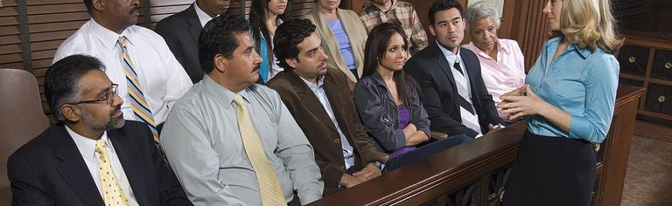
DIFFERENCE BETWEEN LAW AND FACT
Decisions of fact do not create binding precedent
To be binding, the judgment must be concerned with a question of law, not a question of fact
Questions of fact can be proven or disproved
Juries can decide questions of fact
Questions of law can only be answered by applying legal principles
Only judges can decide on questions of law

Slide 39

RATIO DECIDENDI
The ratio of a case is the legal rule and associated reasoning essential to the resolution of the case.

Slide 40

Correct or not correct
Every case has a ratio
There is only one ratio in each case
A ratio can always be found by reading only that case
The ratio does not and cannot change over time

Slide 41
IDENTIFYING THE RATIO DECIDENDI
The ratio can be found with the use of skill and interpretation based on experience
Lord Asquith
‘The rule is quite simple, if you agree with the other bloke you say [the statement] is part of the ratio; if you don’t you say it is obiter dictum, with the implication that he is a congenital idiot’.
Karl Llewellyn
‘there is no single right and correct way of reading one case, or of reading a bunch of cases and that a court’s decision might turn on what the judge had for breakfast’. (The Common Law Tradition: Deciding Appeals)

Slide 42

TOPIC FOUR: How to use cases in your studies

Slide 43

IDENTIFYING THE RATIO
Consider the material facts
What were the principle reasons for the judge/s decision?
How has the ratio been interpreted in subsequent cases?

Slide 44
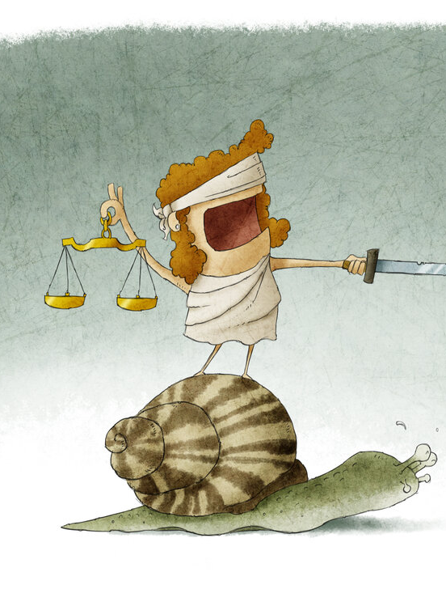
IDENTIFYING THE MATERIAL FACTS
Donoghue v Stevenson [1932] AC 562
Mrs Donoghue and a friend went to a café in Paisley, and her friend bought her a bottle of ginger beer, which came in a dark glass bottle. Mrs Donoghue drank some of the beer and found a snail in the bottle. She fell ill and suffered shock and gastroenteritis. She sued the manufacturer.

Slide 45
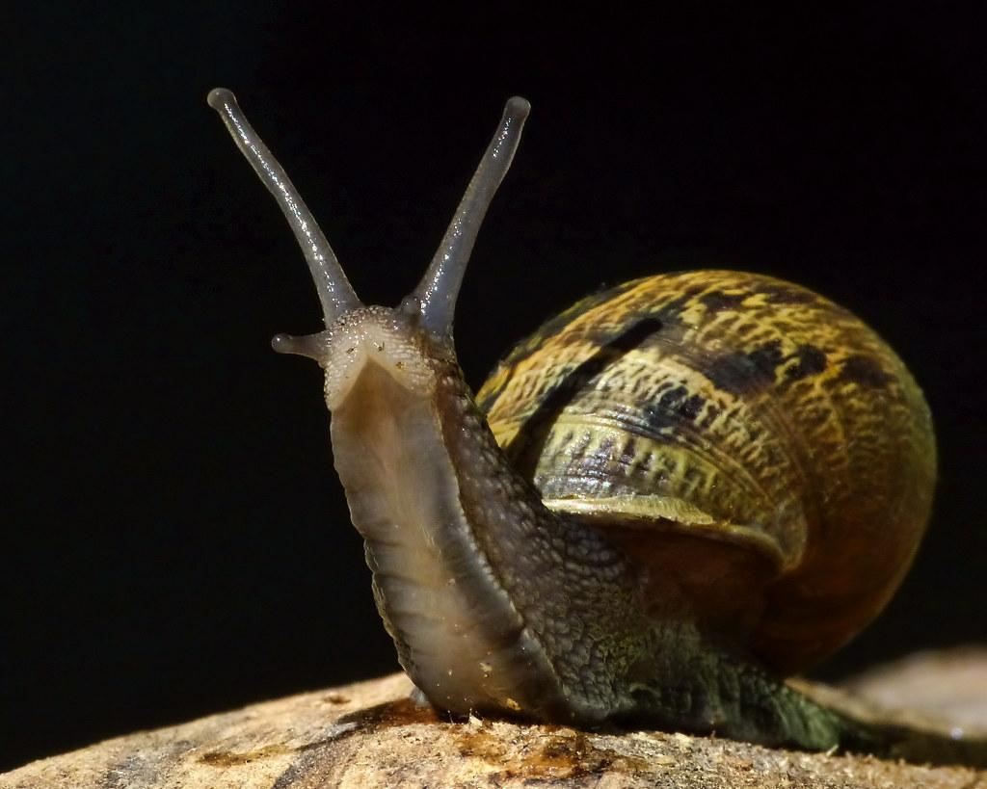
IDENTIFYING THE MATERIAL FACTS
The incident happened in Paisley
The bottle was opaque
Mrs Donoghue’s friend paid for the drink
Mrs Donoghue suffered injury
Mrs Donoghue was injured by a defective product
Mrs Donoghue sued the manufacturer
The decomposing creature was a snail
Mrs Donoghue was a ‘pauper’

Slide 46
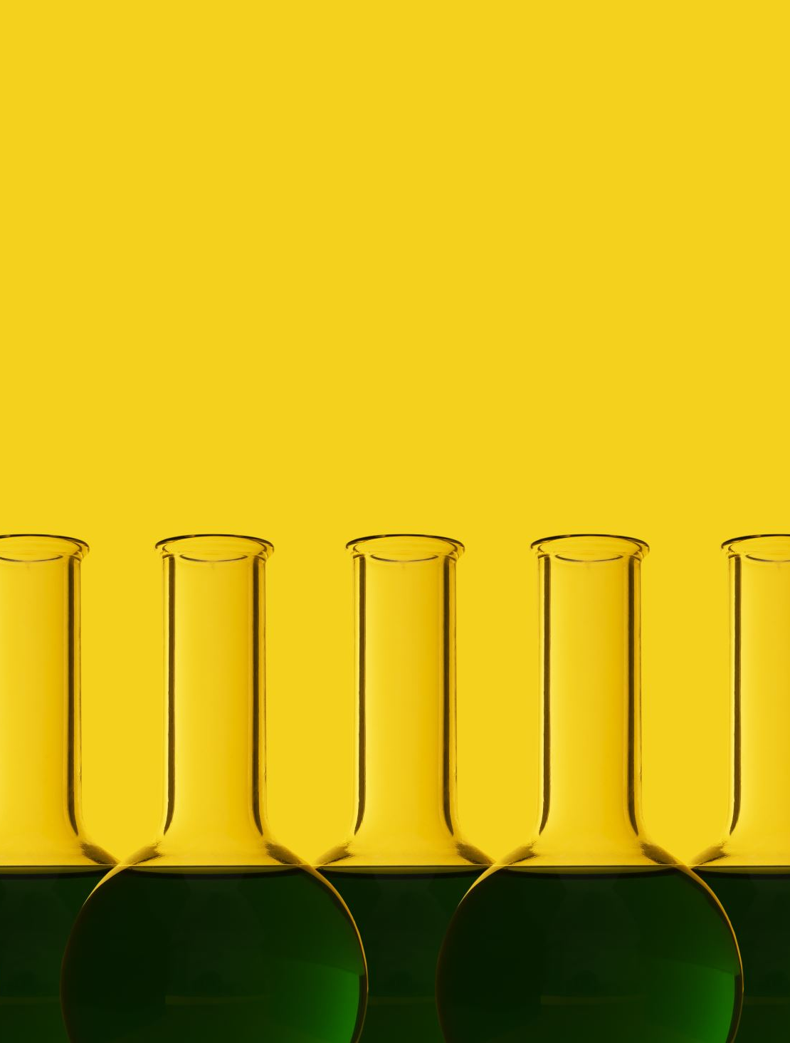
IDENTIFYING THE RATIO (NARROW)
‘The question is whether the manufacturer of an article of drink sold by him to a distributor, in circumstances which prevent the distributor or the ultimate purchaser or consumer from discovering by inspection any defect, is under any legal duty to the ultimate purchaser or consumer to take reasonable care that the article is free from defect likely to cause injury to health’.
Lord Atkin

Slide 47
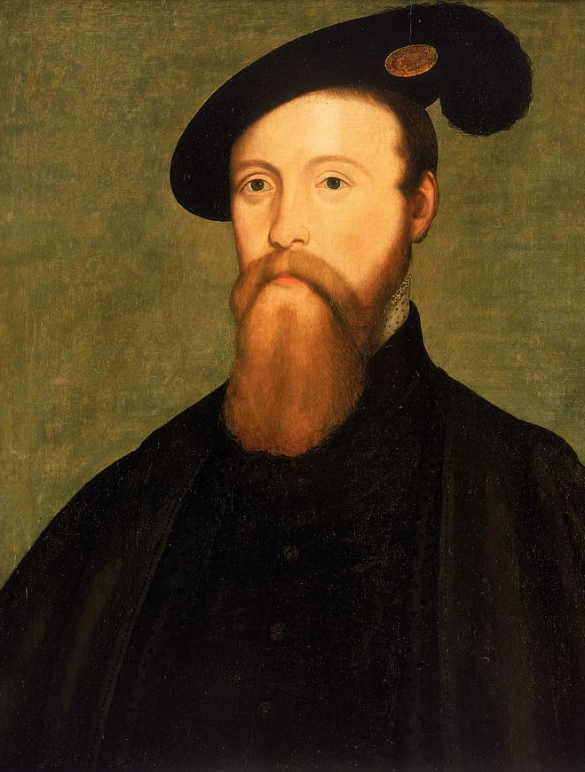
IDENTIFYING THE RATIO (WIDE)
‘You must take reasonable care to avoid acts or omissions which you can reasonably foresee would be likely to injure your neighbour. Who, then, in law is my neighbour? The answer seems to be - persons who are so closely and directly affected by my act that I ought reasonably to have them in contemplation as being so affected when I am directing my mind to the acts or omissions which are called in question’.
Lord Atkin
This Photo by Unknown Author is licensed under CC BY-NC-ND

Slide 48

ATTEMPTS TO LIMIT THE RATIO
Lord Atkin:
‘I venture to say that in the branch of the law which deals with civil wrongs, dependent in England at any rate entirely upon the application by judges of general principles also formulated by judges, it is of particular importance to guard against the danger of stating propositions of law in wider terms than is necessary, lest essential factors be omitted in the wider survey and the inherent adaptability of English law be unduly restricted. For this reason it is very necessary in considering reported cases in the law of torts that the actual decision alone should carry authority, proper weight, of course, being given to the dicta of the judges’.
Donoghue v Stevenson [1932] AC 562

Slide 49
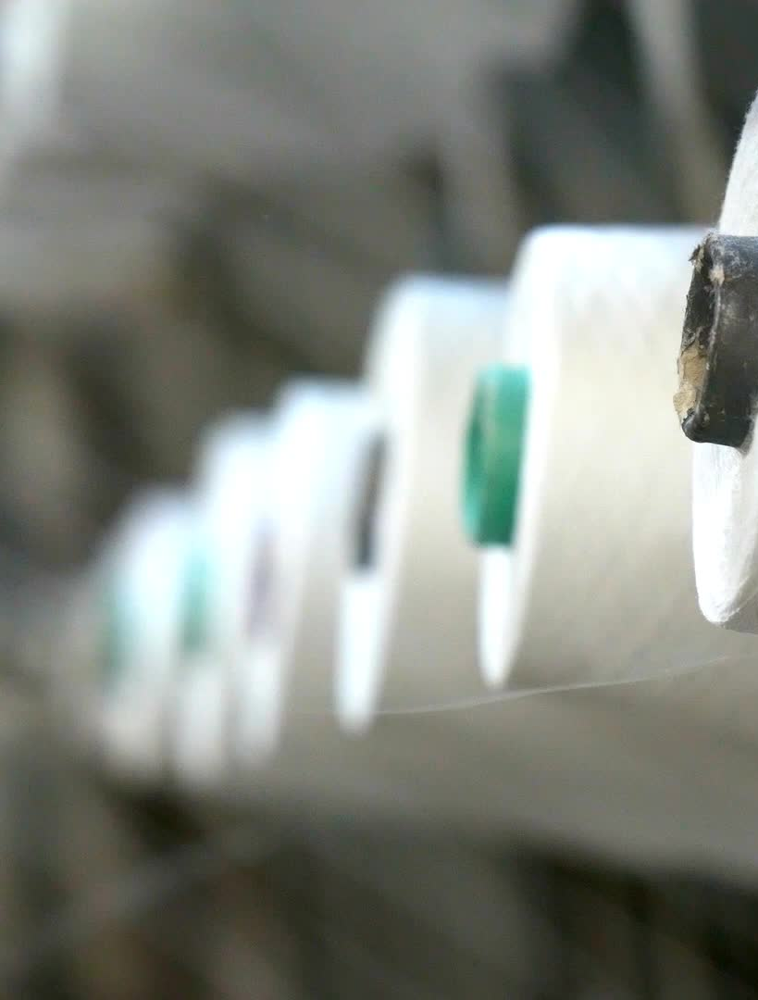
EXTENDING THE RATIO
The appellant contracted dermatitis as the result of wearing a woollen garment which, when purchased from the retailers, was in a defective condition owing to the presence of excess sulphites which had been negligently left in it in the process of manufacture. He claimed damages against both retailers and manufacturers:-
The presence of the deleterious chemical in the garment was a hidden and latent defect, and could not be detected by any examination that could reasonably be made; nothing happened between the making of the garment and its being worn to change its condition; and the garment was made by the manufacturers for the purpose of being worn exactly as it was worn in fact by the appellant.
Grant v Australian Knitting Mills (1936) AC 85 (PC)

Slide 50

EXTENDING THE RATIO
‘In order to ascertain whether the principle applies to the present case, it is necessary to define what the decision involves, and consider the points of distinction relied upon before their Lordships’.
‘The presence of the deleterious chemical in the pants, due to negligence in manufacture, was a hidden and latent defect, just as much as were the remains of the snail in the opaque bottle: it could not be detected by any examination that could reasonably be made. Nothing happened between the making of the garments and their being worn to change their condition. The garments were made by the manufacturers for the purpose of being worn exactly as they were worn in fact by the appellant: it was not contemplated that they should be first washed’.
Lord Wright

Slide 51
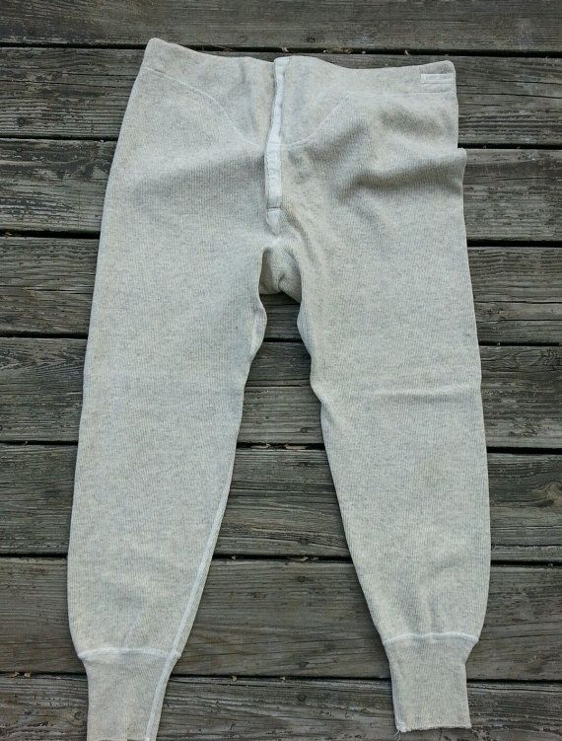
DISTINGUISHING/AVOIDING THE RATIO
Food and drink are consumed internally, pants are worn externally
The pants could be handled and inspected by others before reaching the consumer
If the ratio in Donoghue were to be extended the manufacturers liability would be extended indefinitely

Slide 52
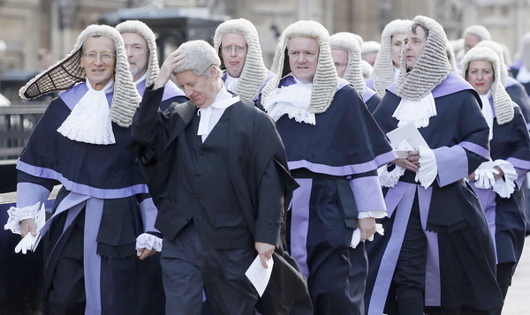
OBITER DICTA
Obiter comments include:
Discussion, explanation or reasoning of the judge that is wider than necessary to reach a decision on the facts of the case
Hypothesising about what decision the he would have reached if the facts had been different
Explanation of what the decision would have been had he not been compelled to reach a different decision in order to follow precedent
Comments made by a dissenting judge
This Photo by Unknown Author is licensed under CC BY-ND

Slide 53
OBITER DICTA
Donoghue v Stevenson
‘There can be no special duty attaching to the manufacture of food apart from that implied by contract or imposed by statute. If such a duty exists, it seems to me it must cover the construction of every article, and I cannot see any reason why it should not apply to the construction of a house. If one step, why not fifty?’.
Lord Buckmaster
‘Upon the view which I take of the matter, the reported cases—some directly, others impliedly—negative the existence as part of the common law of England of any principle affording support to the appellant's claim, and therefore there is, in my opinion, no material form which it is legitimate for your Lordships' House to deduce such a principle.’
Lord Tomlin

Slide 54
ARE JUDGES MAKING THE LAW?
Lord Denning:
‘My root belief is that the proper role of the judge is to do justice between the parties before him. If there is any rule of law which impairs the doing of justice, then it is the province of the judge to do all that he legitimately can to avoid the rule – or even change it – so as to do justice in the instant case before him. He need not wait for legislation to intervene: because that can never be of any help in the instant case. I would emphasize, however, the word ‘legitimately’: the judge is himself subject to the law and must abide by it’.

Slide 55
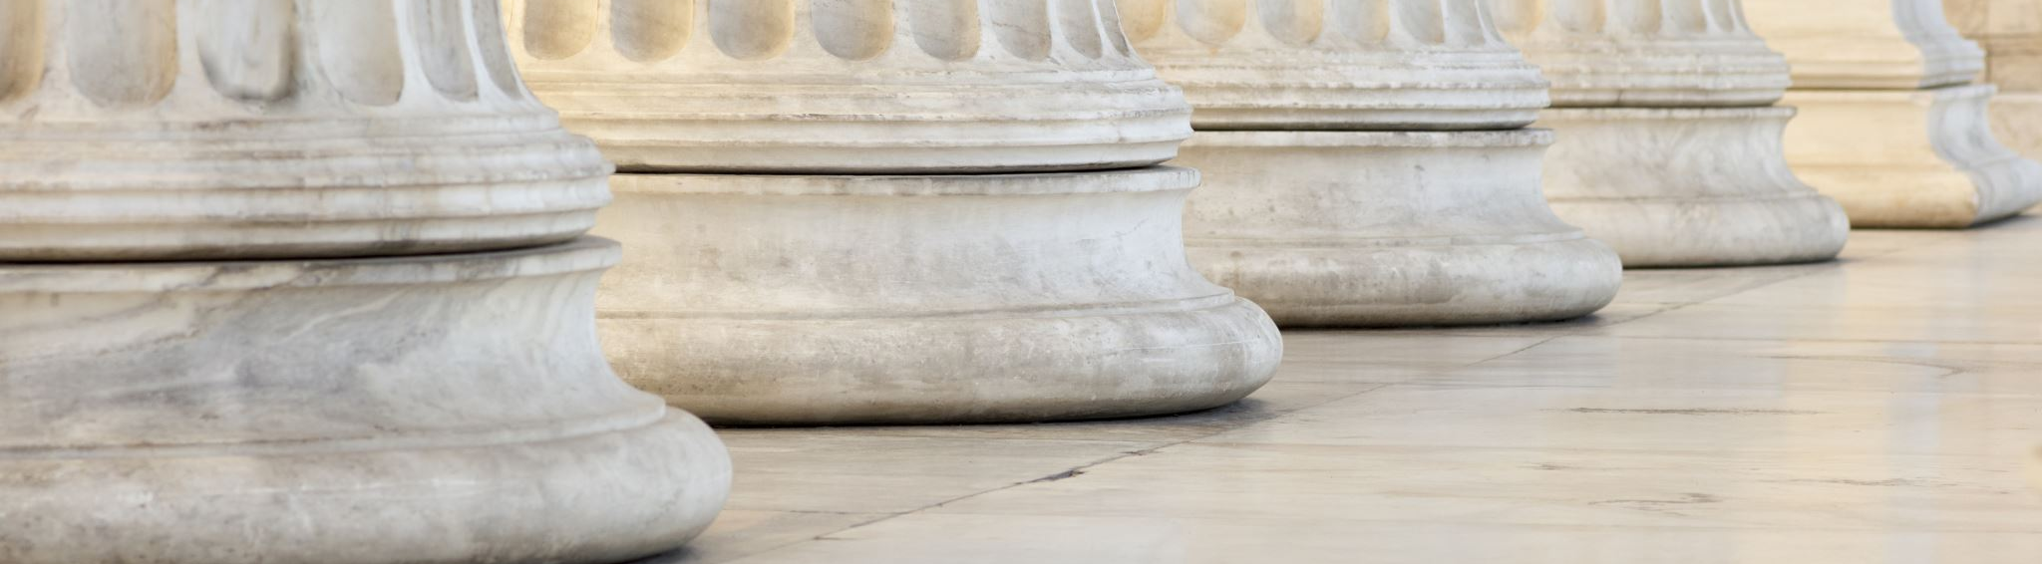
ARE JUDGES MAKING THE LAW?
‘The court's function is to adjudicate according to principle, leaving policy curtailment to the judgment of Parliament. Here lies the true role of the two law-making institutions in our constitution. By concentrating on principle the judges can keep the common law alive, flexible and consistent, and can keep the legal system clear of policy problems which neither they, nor the forensic process which it is their duty to operate, are equipped to resolve. If principle leads to results which are thought to be socially unacceptable, Parliament can legislate to draw a line or map out a new path’.
Lord Scarman McLoughlin v O’Brien [1983]

Slide 56
CHECKLIST FOR APPLYING PRECEDENT
Are there any material differences on the facts?
Is the ratio clear?
Was the decision made per incuriam?
Has the decision been doubted since?
Do obiter comments help?
Has the decision been criticised by academics?
Have social conditions or policy concerns changed since the decision was made?

Slide 57
CITING CASES
Cases are cited by their name and their ‘neutral citation’ (since 2001) and/or their location in the law reports (Year, Court, Reference number)
UKSC – UK Supreme Court
UKHL – House of Lords
UKPC – Privy Council
EWCA Civ – Court of Appeal Civil Division
EWCA Crim – Court of Appeal Criminal Division
EWHC – High Court (followed by the division abbreviation or ‘Admin’ for Administrative Court

Slide 58
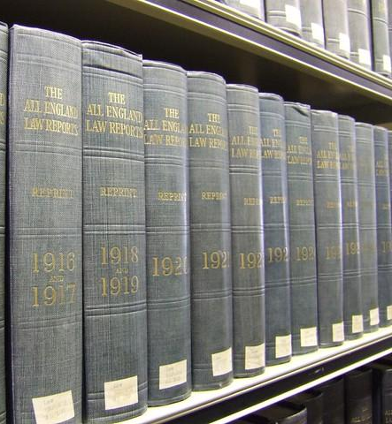
CITING CASES
Cole v Turner (1705) 6 Mod Rep 149
Stephens v Myers (1830) 4 C&P 349
Corcoran v Anderton (1980) 71 Cr App R 104
McLoughlin v O’Brien [1983] 1 AC 410
DPP v Patterson [2017] EWHC 2820 (Admin)
R v Agera [2017] EWCA Crim 74
Ivey v Genting Casinos [2017] UKSC 67

Slide 59

Referencing
OSCOLA CASELAW
This Photo by Unknown Author is licensed under CC BY-SA

Slide 60

PART TWO
Group Exercise

Slide 61
Background and task
Background: Family Law addresses matrimonial, finance (inheritance law, retirements, pensions, and other benefits) and child law. It also covers domestic violence, guardianship, child abuse, and neglect
Task: read the summary of facts and discuss what the judgment might have been; apply or distinguish previous case(s)

Slide 62
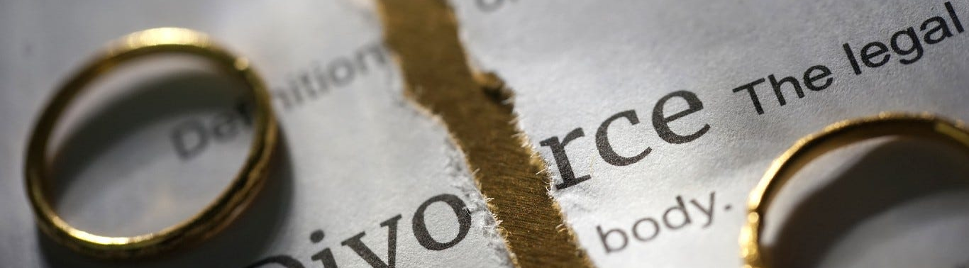
White v White [2000]
Mr and Mrs White were married for 33 years and had three children. They both came from farming families and jointly owned a farm with a large farmhouse and 160 acres of land. They had a loan from the husband’s father. During the marriage, they increased their land ownership to 337 acres. By 1996, when Mrs White started financial proceedings in divorce, the entire farm was worth £3.5 million.
Mr White had inherited and owned a separate farm, and while running the joint farm in partnership, Mrs White was active in running that and being the primary carer for the three children.
This Photo by Unknown Author is licensed under CC BY

Slide 63
Sharing principle
“A practical consideration follows from this. Sometimes, having carried out the statutory exercise, the judge’s conclusion involves a more or less equal division of the available assets. More often, this is not so. More often, having looked at all the circumstances, the judge’s decision means that one party will receive a bigger share than the other. Before reaching a firm conclusion and making an order along these lines, a judge would always be well advised to check his tentative views against the yardstick of equality of division. As a general guide, equality should be departed from only if, and to the extent that, there is good reason for doing so.”
Lord Nicholls

Slide 64
The ruling
Ratio decidendi: the rule necessary for resolving the issue under discussion
Obiter dictum: other observations
Responding to arguments of counsel
Identifying issues to be resolved in the future
The limits of rulings
Positive rules
Negative rules

Slide 65
Distinguishing
Following = applying the rule exactly to facts
Strong distinguishing = changing the rule by adding a qualification
Weak distinguishing = Explaining why the facts in the instant case do not fit within the ruling

Slide 66

Group Exercise
This Photo by Unknown Author is licensed under CC BY-NC-ND

Slide 67
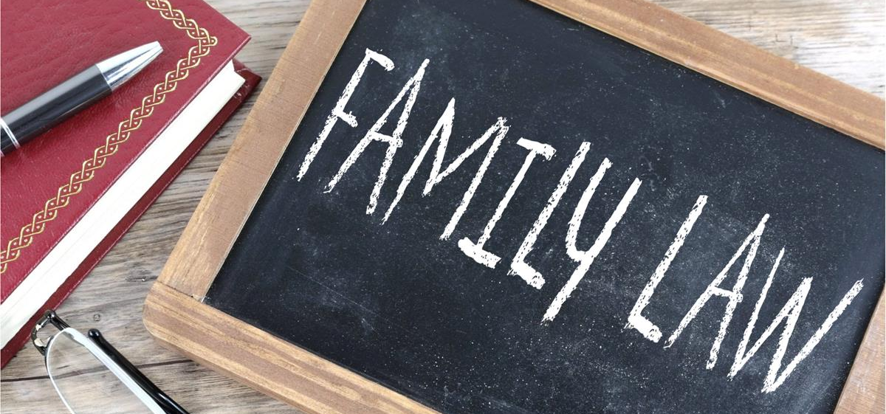

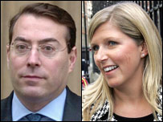
Case #2
This Photo by Unknown Author is licensed under CC BY-SA
Miller v Miller
This Photo by Unknown Author is licensed under CC BY-SA

Slide 68
Summary
The parties had been married for less than three years and had no children. The husband was a very high earner and had brought substantial wealth into the marriage. That wealth increased considerably during the marriage; his worth was approximately £32 million. On the other hand, the wife’s assets were worth substantially less than her legal costs. The judge initially concluded that a lump sum to the wife of £5 million was fair and awarded her that sum. The husband appealed to the Court of Appeal but was dismissed. The husband then appealed again to the House of Lords.

Slide 69
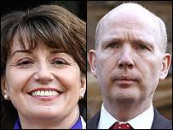
CASE # 3
McFarlane v McFarlane
At the time of the marriage, both parties had successful careers. However, the wife, Julia McFarlane, had given up a successful career in law to raise the family’s three children. The marriage ended after 16 years. The couple had assets of around £3 million, which they agreed to share but could not agree on the periodic payments.

Slide 70
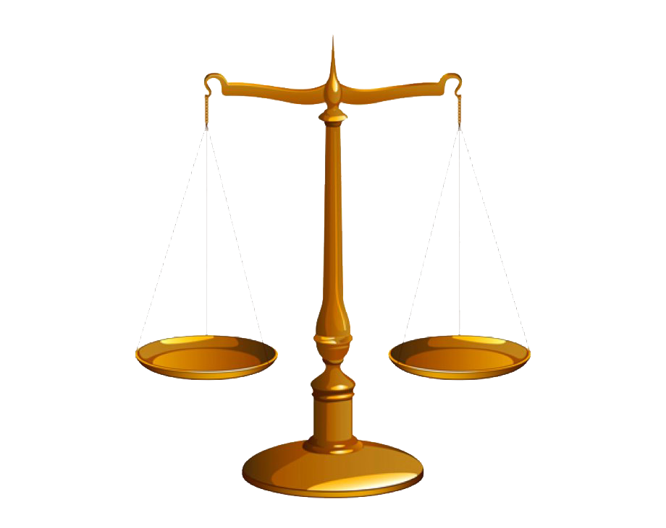
APPEAL
Discussion
Is it fair?
This Photo by Unknown Author is licensed under CC BY-NC

Slide 71

Fairness
In White, the court confirmed that the overall aim is to achieve fairness between the parties
Non-financial and financial contributions are to be valued equally.
Miller; McFarlane provided additional guidance
The first stage is to ensure the parties' needs are met and they are compensated for any relationship-generated disadvantage before applying the equal sharing principle to the remaining matrimonial assets.

Slide 72
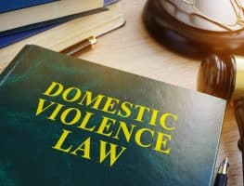
Case # 4
Domestic violence
This Photo by Unknown Author is licensed under CC BY-NC-ND

Slide 73
Molestation
C v. C (Non-molestation Order: Jurisdiction) [1998] 1 FLR 554
Sir Stephen Brown P:
There is no legal definition of 'molestation'. Molestation involves any form of physical, sexual or psychological molestation or harassment that has a serious impact on the health and well-being of the applicant. Violence is not a prerequisite.
A positive intent to molest does not need to be established nor does there need to be some direct interaction between the respondent and the applicant or child. It is sufficient if the conduct is deliberate and that it has the consequence of causing or being likely to cause distress or harassment to the applicant or a child.

Slide 74
Johnson v Walton [1990] 1 FLR 350
Mr. Walton sent semi-naked photos of his former girlfriend to the press without her consent.
• The photos were intended to embarrass and humiliate the woman, constituting a severe breach of her privacy and dignity.
• The case was brought under the grounds of harassment, with the claim that Walton's actions amounted to molestation under the legal definition.
sending semi-naked pics to the newspapers of the Wife- it was causing distress deliberate intention to cause distress. Revenge porn is part of the molestation.

Slide 75

Lord Donaldson: harassment involves an element of intent, specifically the intent to cause distress or harm. The nature of Walton’s actions—publicly disseminating intimate photos to cause embarrassment—was found to be a deliberate and targeted form of harassment.
The Court of Appeal: Any behaviour intended to cause distress

Slide 76
Retrospective and Prospective Overruling
‘’The ruling will have a retrospective effect so far as the parties to the particular dispute are concerned . . . Further, because of the doctrine of precedent, the same would be true of everyone else whose case thereafter came before a court. Their rights and obligations would be decided according to the law as enunciated by [the court] in that case even though the relevant events occurred before that decision was given. [8] People generally conduct their affairs on the basis of what they understand the law to be. This ‘retrospective’ effect of a change in the law of this nature can have disruptive and seemingly unfair consequences’’.
Re Spectrum Plus Ltd (In Liquidation) [2005] UKHL 41; [2005] 3 WLR 58 Lord Nicholls

Slide 77
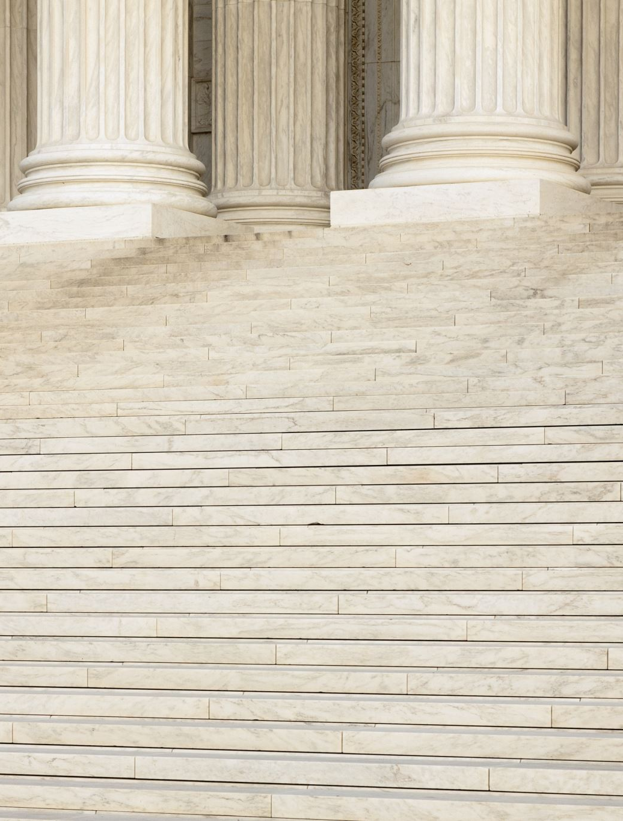
Overruling
This is when a higher court does not follow a precedent set in a previous case, either by a lower court or by itself.

Slide 78
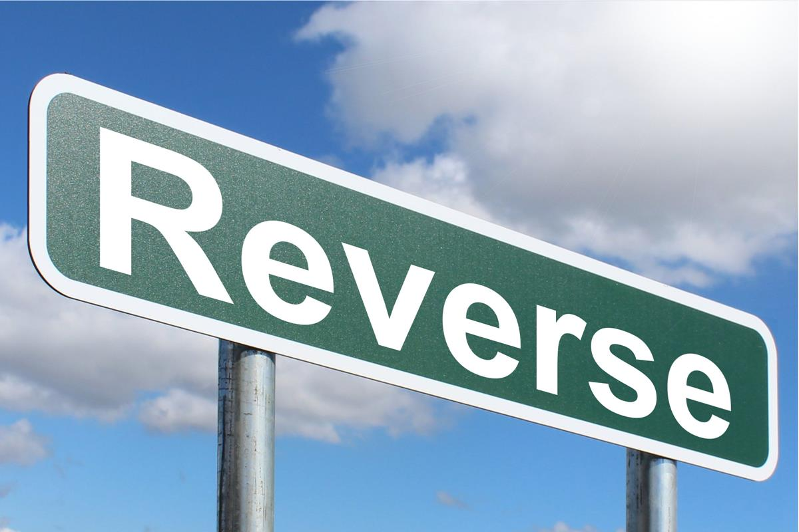
Reversing
A higher court does not follow a precedent set by a lower court in the same case.
An appeal would reach the opposite decision from a lower court.
Fitzpatrick v Sterling House Association Ltd (2000) – CoA refused to allow the homosexual partner of the deceased tenant to take over tenancy as he could not be described as family required under the Rent Act 1977
The HoL reversed the decision and held that he could on the principle that a same-sex partner could prove the familial link as required by the legislation.
This Photo by Unknown Author is licensed under CC BY-SA

Slide 79

Precedent?
R (on the application of Black) (Appellant) v Secretary of State for Justice (Respondent)
[2017] UKSC 81

Slide 80
What’s next…
S4: Stare decisis
L4: Court system
The United Kingdom has three separate legal systems; one each for England and Wales, Scotland and Northern Ireland. This lecture deals with the judicial system of England and Wales, which comprises courts and tribunals. You will be introduced to the court structure and the trajectory of cases that progress within the structure. You will also be introduced to the relevance of certain foreign courts to the legal system of England and Wales. In the workshop, you will be introduced to the legal systems of Scotland and Northern Ireland.
Find and read Fagan v Commissioner of Metropolitan Police [1969] 1 QB 439 on Westlaw. List the cases it cites and those citing it. What is the ratio and obiter?

Slide 81
Questions at VEVOX
https://royalholloway.display.vevox.com#/present/642997/1PDB9CRKOR2AUJ1WYRS4

Slide 82

Thank you
Any question?

